Slide 1
Gospel of Mark Part IV The Passion of our Lord
Ascension Men’s Bible Study

Slide 2
Review
Session One: An overview of the Gospel of Mark
Session Two: Preparation for Jesus’ public ministry
Session Three: Calling the disciples and naming the Apostles. Calling of today’s priests
Session Four: Jesus established his authority, taught his disciples and gave authority to the apostles.
Session Five: Jesus revealed his “mystery” to the apostles and disciples.

Slide 3
EVENTS IN THE PASSION OF OUR LORD Chapter 14:10-15:47
Judas agrees to betray Jesus
Preparations for the Passover
The Betrayer
Lord’s Supper
Peter’s denial Foretold
Agony in the Garden
Betrayal and Arrest of Jesus
Jesus before the Sanhedrin
Peter’s denial
Jesus before Pilate
Sentence of Death
Mockery by the soldiers
Way of the Cross
The Crucifixion
Death of Jesus
Burial of Jesus

Slide 4
Word Study
Passover
Eucharist
Blood of the Covenant
Unleavened Bread
Host
Sanhedrin
Golgotha
Wine mingled with Myrrh
Crucifixion

Slide 5
Passover, Blood of Covenant, Lord’s Supper
Read Mk 14:12-25 pg 1427. Ex 12:1-20 pg 95, Ex 24:1-10 pg 112
Passover:
Unleavened bread
Wine- reminder of the blood of sacrifice
Sacrificial victim (lamb)
Priest – Moses was High Priest
Gift of Life by the lamb
Deliverance of Israel from Egypt
Hallel hymns –Psalms 115-118 pgs 812-815 - part of Passover liturgy
Commanded to celebrate forever
Lord’s Supper/ Eucharist
Host – “This is my body”
Wine – “This is my blood
Jesus –Sacrificial Victim
Jesus – High Priest
Jesus gives his life
All are forgiven and delivered from sin to life
Hymns sung as part of Mass
Eucharist is celebrated each time we assemble
O.T. Blood of the Covenant
Sealed with blood of sacrifice at Mt. Sinai
N.T. Blood of the Covenant
Sealed with Christ’s blood at the Upper Room and then on the Cross

Slide 6
Denial/Betrayal
Zechariah 13:7 page 1316
Foretold that the Messianic shepherd would be struck down.
Flock would be without a shepherd temporally
Mark 14:26-31 page 1428
Jesus’ arrest sets in motion the trials and his disciples scatter in fear.
Peter denies him.
Jesus is in the grave for 3 days
Read Mark 14:43-51pg 1429 , Matt 26:55-56 pg 1393
Jesus quotes Zechariah in his statement to the disciples

Slide 7
Trials
Jesus is now judged before the entire Sanhedrin and the before Pilate.
Sanhedrin: Supreme Court of the Jews:
Primary role to enforce Jewish law and custom
Consisted of 71 members
High Priest:
Elders of Jerusalem’s leading families
Chief Priests – from whom the High Priest was selected
Scribes – professional lawyers
The Sanhedrin was given power to legislate nearly all situations of the Hebrew people except capital punishment
Pilate had the authority to order capital punishment
Authority assigned to him from Rome

Slide 8
Accusations/Judgment
Sanhedrin accused Jesus of Blasphemy
Mark 14:64 pg 1429, Leviticus 24:16 pg 166. His claim to the heavenly throne was an insult to God’s name.
A capital crime punishable by death
Pilate succumbs to the wishes of the crowd
Gives them the choice of a convicted fellon sentenced to death – Barabbas or Jesus
Crowd chooses Barabbas, thus leaving Jesus condemned to death

Slide 9
Humiliation
Peter’s Denial: Mark 14:66-72 pg 1429
Even the closest associate of Jesus denied him
The rest of the disciples had fled
The soldiers mock Jesus
Clothed him in purple cloak
Saluted him as king of the Jews
Struck him
Spat on him
Knelt down and did homage to himy
Ironically they did not know He was a real king
Led him out to crucify him

Slide 10
Crucifixion/Death
Golgotha
Place of the Skull
Common place of execution
Latin vulgate translation: calvariae – hence the common term Calvary
Wine mingled with Myrrh
Narcotic pain killer.
Jesus refused it so that he might bear the full weight of suffering for man’s sins.
Crucifixion
Nailed by hands and feet to a cross
Reserved for the most heinous crimes
Death was very slow
Caused by blood loss and asphyxiation
Could be sped up by breaking the legs
Corpses were often left hanging for days as a deterrent to crime

Slide 11
Death/Burial
Mark 15:34 pg 1431. Jesus cries out Elo-i, Elo-I lama sabbachthani. My God, My God, why have you abandoned me? Jesus is quoting Psalm 22:1 pg 742
The scriptures were as well known to the Hebrew people- especially the well educated - as our prayers and responses in Mass are known to us. These first words of the psalm would recall the entire psalm for them.
In Mark14:62 pg 1429 Jesus quotes from Psalm 110:1 Again, the Hebrews would have known the whole psalm from this quotation.
Christians see Jesus’ physical death as the antithesis of Adam’s spiritual death at the tree of good and evil. Gen 3:6, 17-19
Adam’s spiritual death brought death to the entire human family
Jesus’ death, followed by his resurrection, rescues man from sin and gives him new life in the family of God: Roman’s 5:12-19 pg 1585

Slide 12
Word Study
Passover – celebration of deliverance from Egypt
Eucharist – celebration of Christ’s real presence with us and deliverance from sin
Blood of the Covenant – shed from a lamb for deliverance of Hebrews from Egypt, shed by Jesus for deliverance of all mankind from sin
Unleavened Bread – prepared in haste for the exit from Egypt
Host – unleavened bread which when consecrated becomes for us the body of Christ
Sanhedrin- Ruling body of the Hebrew people
Golgotha – place of the skull or execution – Latin vulgate translation becomes Calvary
Wine mingled with Myrrh – a narcotic pain killer which Jesus refused
Crucifixion – most cruel means of capital punishment which Jesus willingly accepted to save us from our sins and bring us to eternal life with him.

Slide 13
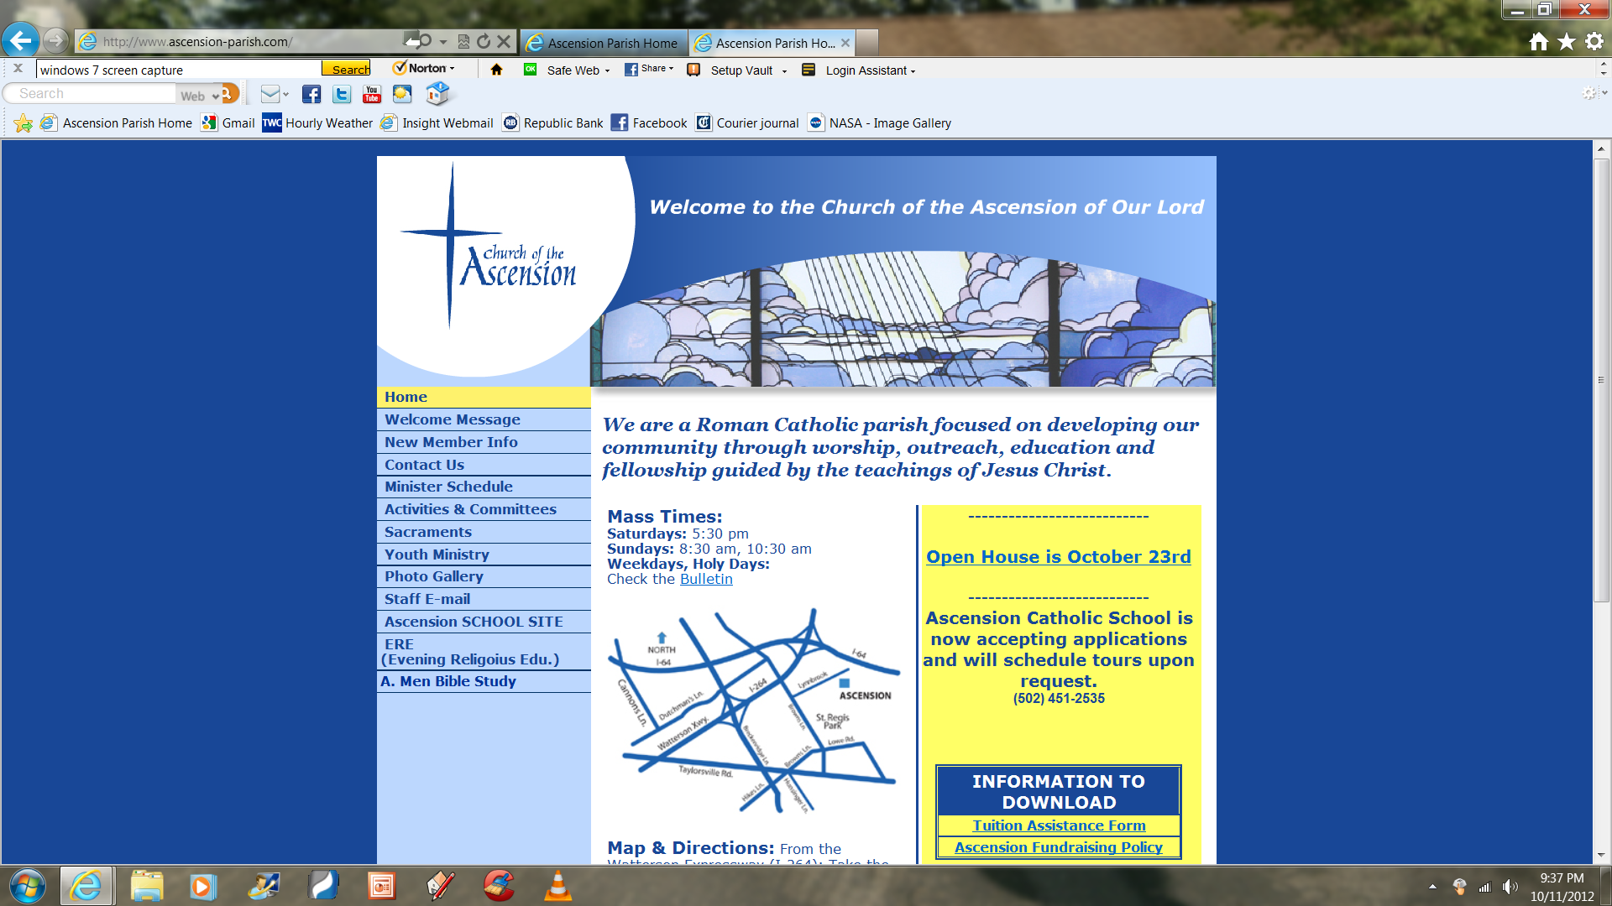
A-Men Bible Study Notes are now on the Ascension Church website.
To access go to http://www.ascension-parish.com
Click on A-Men Bible Study

Slide 14
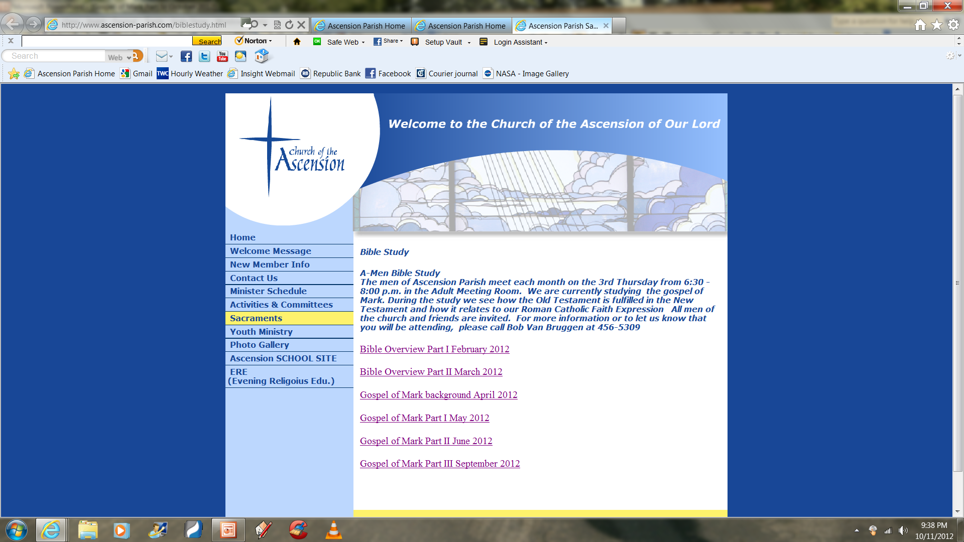
Click on the Bible study notes you need to open the Power-point presentation.
If you do not have the correct version of Power-point it should direct you to a download that will allow your version to read the presentation.

Slide 15
THE RESURRECTION OF JESUS
The Resurrection
Appearance of Mary
Appearance to Two Disciples
Commissioning of the Elders
The Ascension of Jesus

Slide 16
Next Bible Study
Select another book
Select questions/issues to investigate
Use a study guide
Time schedule – 6:30-8:00 or 7-8:00?
Frequency – 1 time per month? More often?
Leadership – Would anyone else like to lead a study or share in the leadership?
Other changes/adjustments?

